Slide 1
FNB
SALES PERFORMANCE
Sales performance
analysis
186.9M
TOTAL SALES
Management overview | Revenue, profitability and demand patterns
2013–Jan 2017 dashboard coverage
Prepared from the attached dashboard
Notes:
Open with the central tension: the business generated meaningful sales volume, but costs exceeded sales overall.

Slide 2
EXECUTIVE VIEW
02
Scale is present — profitability is the constraint
The dashboard reports a cumulative gross loss despite 186.9M in sales.
186.9M
194.0M
-7.1M
5.3M
-3.81%
Total sales
Total cost
Gross profit
Units sold
Avg GP %
Three management takeaways
Cost base is above revenue
Demand concentrates late in the week
Performance weakened over time
Overall cost exceeds sales by 7.1M; margin recovery is the immediate priority.
Friday and Saturday are the strongest sales days, creating a clear staffing and stock window.
Annual sales fell from 75M in 2014 to 47M in 2016, while cost stayed above sales.
Decision lens
Protect peak-day availability, fix loss-making unit economics, and investigate the post-2014 sales decline by product, branch and customer segment.
Source: FNB Sales DataStudio Report
CONFIDENTIAL • MANAGEMENT VIEW
Notes:
Use this page as the one-minute summary. The dashboard points to a margin problem first, then a demand concentration opportunity, then a structural sales decline.

Slide 3
PERFORMANCE TRAJECTORY
03
Sales declined 37% from 2014 to 2016
Costs remained above sales in every full year shown.
ANNUAL SALES CHANGE
−37%
2014 → 2016
GROSS LOSS BY YEAR
2014
-2M
2015
-4M
2016
-1M
Read-through
2015 carried the largest annual loss in the dashboard. 2016 narrowed the loss, but on a materially smaller sales base.
Source: FNB Sales DataStudio Report
CONFIDENTIAL • MANAGEMENT VIEW
Notes:
The key message is not only that sales declined. Cost remained higher than sales throughout, so the business did not convert scale into gross profit.

Slide 4
SEASONALITY
04
May is the strongest month; Q4 2016 drops sharply
Monthly and quarterly views indicate both recurring seasonality and a late-period slowdown.
QUARTERLY SALES
18
20.5
22
2014
14.3
Q1
Q2
Q3
Q4
2015
19.7
18.3
14
12.2
Q1
Q2
Q3
Q4
2016
13.4
18.6
10.8
4.4
Q1
Q2
Q3
Q4
Critical signal
2016 Q4 sales were 4.4M — 59% below Q3 and the weakest full quarter shown.
Source: FNB Sales DataStudio Report
CONFIDENTIAL • MANAGEMENT VIEW
Notes:
May is the highest month-of-year aggregate. The larger concern is the sharp drop into 2016 Q4, which merits root-cause analysis.

Slide 5
DEMAND PATTERN
05
Friday and Saturday are the commercial peak
Two weekend days contribute one-third of sales; Saturday records the highest daily average.
WEEKLY SALES SHARE
Operational implication
Prioritise stock availability and service capacity from Friday into Saturday; test targeted offers on softer Tuesday, Thursday and Sunday periods.
Source: FNB Sales DataStudio Report
CONFIDENTIAL • MANAGEMENT VIEW
Notes:
Saturday is 96% above Tuesday and Thursday. Use the peak window to protect availability and the softer days for targeted demand generation.

Slide 6
UNIT ECONOMICS
06
Price exceeded cost in only four months
The widest positive spread occurs in October; December shows the deepest negative spread.
POSITIVE MONTHS
Jul
+1.1 / unit
Sep
+0.3 / unit
Oct
+1.3 / unit
Nov
+0.5 / unit
Priority
Focus corrective action on December (−1.5/unit), April (−1.1/unit) and August (−0.9/unit), then validate product-mix effects.
Source: FNB Sales DataStudio Report
CONFIDENTIAL • MANAGEMENT VIEW
Notes:
The chart suggests a recurring price-cost mismatch. Only July, September, October and November show positive unit spread on the displayed averages.

Slide 7
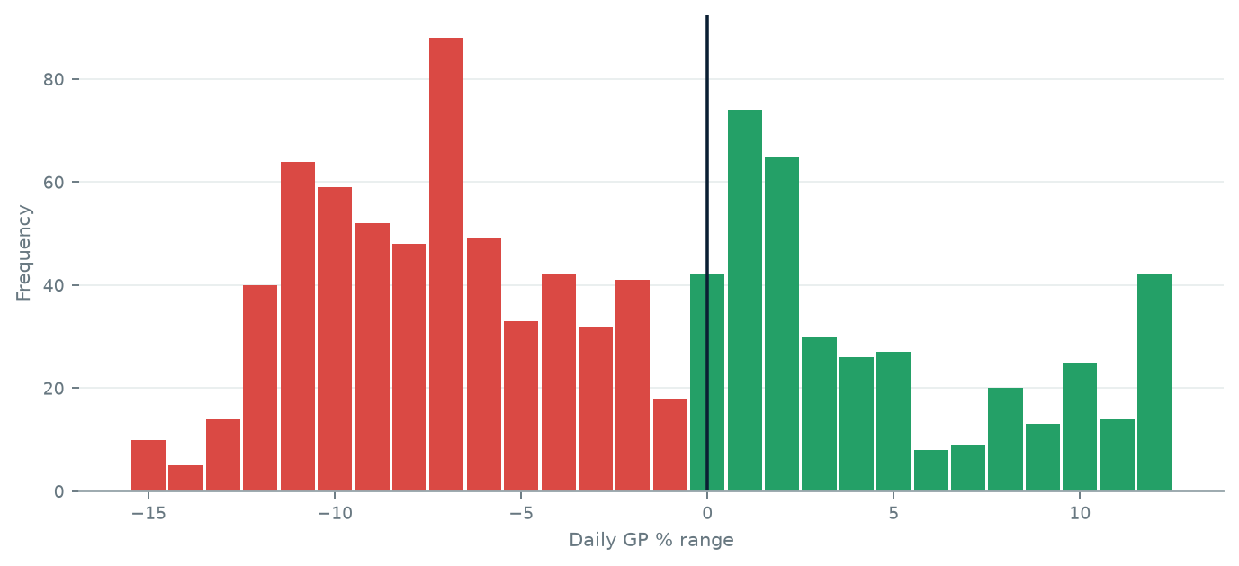
PROFITABILITY PATTERN
07
Loss-making days dominate the distribution
Approximately 62% of daily observations fall below 0% gross profit.
BELOW 0% GP
60%
ABOVE 0% GP
40%
What this means
The loss is broad-based rather than confined to a handful of outliers. Recovery needs repeatable pricing, cost and mix controls.
Source: FNB Sales DataStudio Report
CONFIDENTIAL • MANAGEMENT VIEW
Notes:
The daily distribution shows that negative margin is the norm in the source data. That points to a systemic issue rather than a few exceptional days.

Slide 8
ACTION AGENDA
08
A focused 90-day response
Sequence margin stabilisation before growth acceleration.
01
Stabilise margin
02
Protect peak demand
Set price-cost guardrails by product and branch. Review December, April and August first.
Align stock, staffing and fulfilment to Friday–Saturday volumes; monitor lost-sales indicators.
03
Diagnose decline
04
Build a weekly cockpit
Bridge the 2014–2016 sales contraction by product, branch, customer and volume versus price.
Track sales, unit spread, gross profit and peak-day availability with named owners and thresholds.
Success measures
Positive monthly gross profit • narrowing cost-to-sales gap • recovery in weak quarters • no availability loss on peak days
Success measures
Positive monthly gross profit • narrowing cost-to-sales gap • recovery in weak quarters • no availability loss on peak days
Source: FNB Sales DataStudio Report
CONFIDENTIAL • MANAGEMENT VIEW
Notes:
Close on action. The first 30 days should establish margin guardrails and assign owners; the next 60 should test interventions and monitor weekly results.

Slide 9
APPENDIX
09
Source dashboard
Original pages retained for reference

Slide 10
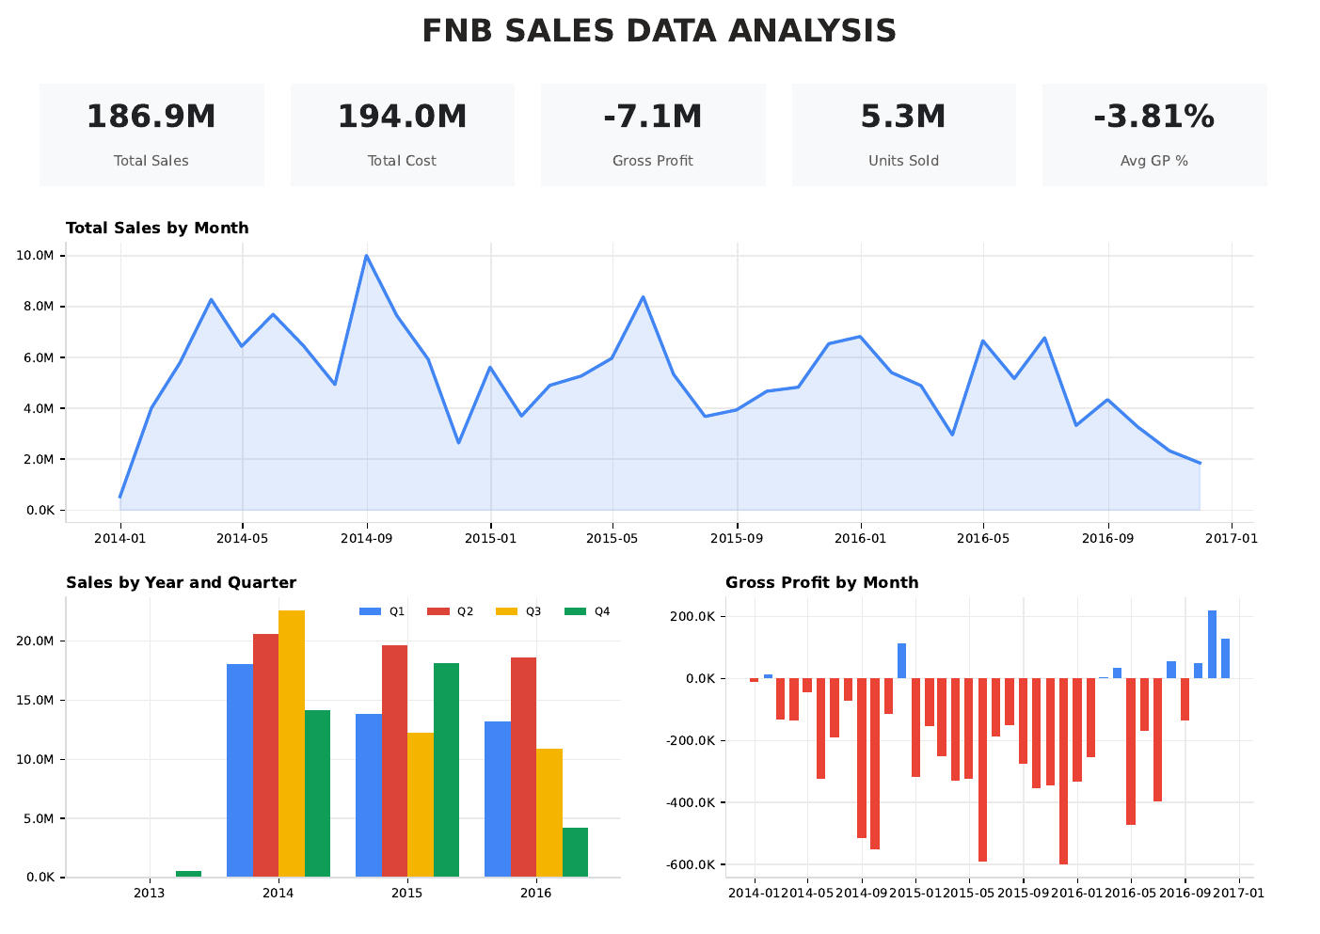
SOURCE DASHBOARD • PAGE 1
10

Slide 11
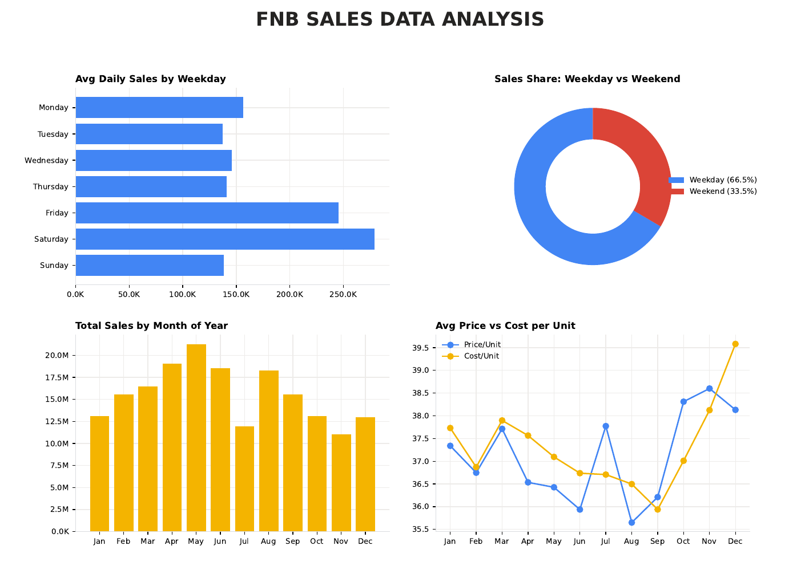
SOURCE DASHBOARD • PAGE 2
11

Slide 12
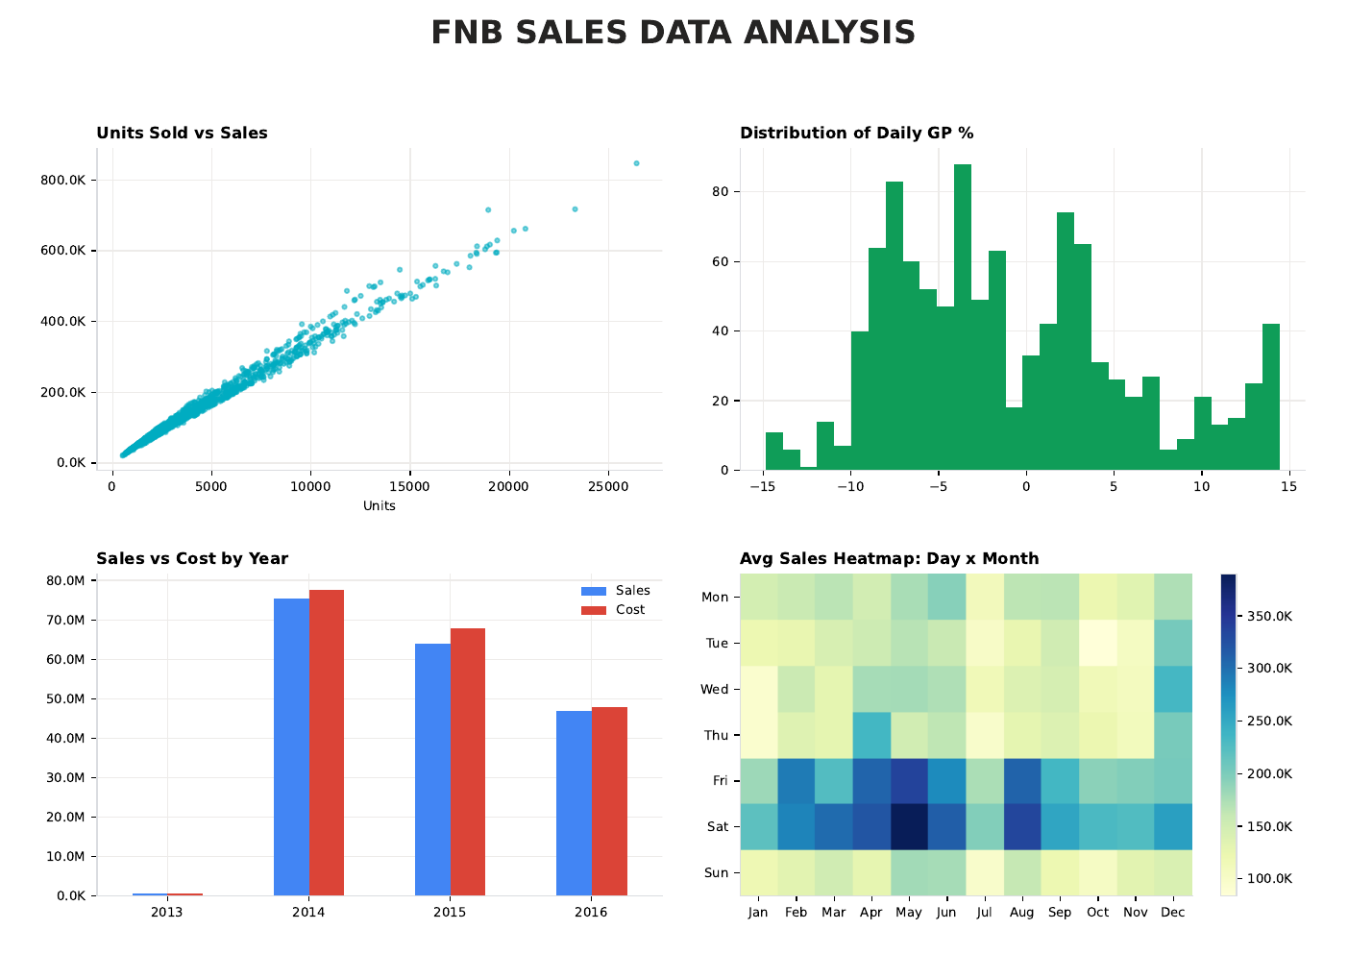
SOURCE DASHBOARD • PAGE 3
12

